Slide 1
Compressing Data via Dimensionality Reduction
By :Dylan Martin

Slide 2
Introduction to Dimensionality Reduction
Dimensionality reduction is a technique used in data processing to reduce the number of random variables under consideration by obtaining a set of principal variables
This serves to simplify large datasets
Focuses on retaining the most significant data
Serves to enhance the performance and quality of data analysis by making complex data interpretable.

Slide 3
I will be going over three dimensionality reduction techniques: PCA
LDA
KPCA

Slide 4
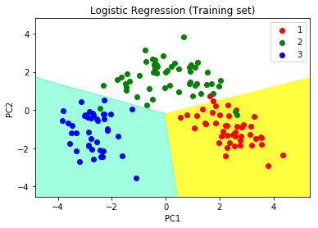
What is PCA
Principal Component Analysis (PCA) is a statistical procedure that uses an orthogonal transformation, (a way of rearranging data in a dataset such that the new axes remain perpendicular to each other) to convert a set of observations of possibly correlated variables into a set of values of linearly uncorrelated variables called principal components.
Data Simplification: PCA reduces the dimensionality of the data while preserving as much of the data's variation as possible
Maximization of Variance: The goal of PCA is to find the directions (principal components) that maximize the variance in a dataset

Slide 5
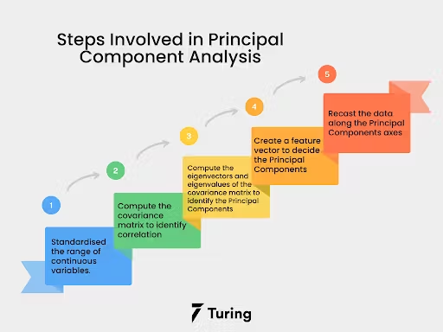
PCA Process Step-by-Step
Data Standardization
"Ensure all variables contribute equally"
Construction of the Covariance Matrix
Measure the covariance between different variables
Decomposing the Covariance Matrix into Eigenvectors and Eigenvalues
Identify the direction and magnitude of data variance
Selecting Principal Components
Choose components that capture the most variance
Transforming the Data onto a New Subspace
Project data onto the new axes of principal components

Slide 6
What is LDA
Linear Discriminant Analysis (LDA) is a statistical technique used to find a linear combination of features that characterizes or separates two or more classes of objects or events.
Maximizes the distance between means of different classes
Minimizes the variation (scatter) within each class.
The primary goal of LDA is to project a dataset onto a lower-dimensional space in order avoid overfitting and reduce computational costs.
Note: LDA is commonly used in pattern and face recognition, medical diagnoses, and machine learning where simplification of classification in high-dimensional spaces is needed

Slide 7
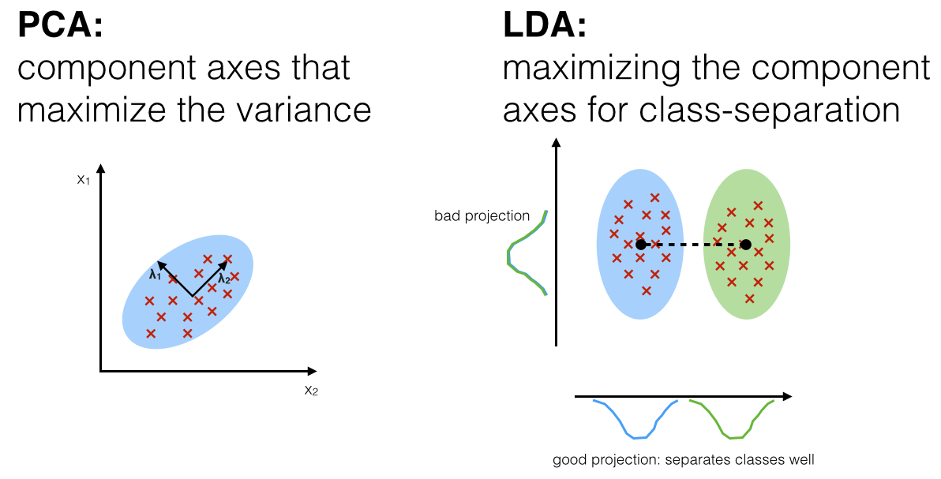
LDA Step-by-Step Process
Compute the Within-Class and Between-Class Scatter Matrices
Used for measuring the dispersion of the classes
Determine the Eigenvalues and Eigenvectors
Sort Eigenvalues and Select Top Eigenvectors
The eigenvectors that correspond to the largest eigenvalues carry the most information about the distribution of the data
Project the Data

Slide 8
What is KPCA
Kernel PCA is an extension of principal component analysis (PCA) using techniques of kernel methods to perform nonlinear dimension reduction
Utilizes kernel functions to enable PCA to perform non-linear mappings
Kernel PCA is used when the data is not linearly separable, making it possible to capture more complex structures
Note: Widely used in image de-noising, feature extraction in text data, and in sectors where complex nonlinear relationships are present.

Slide 9
Kernel PCA Step-by-Step Process
Compute the Kernel Matrix
Transform the original data into a higher-dimensional space using a kernel function.
Center the Kernel Matrix
Adjust the kernel matrix by subtracting the mean to ensure the data is centered in the new feature space
Extract Eigenvalues and Eigenvectors
Compute the eigenvectors and eigenvalues from the centered kernel matrix, which represent the principal components in the new feature space
Project the Data

Slide 10
Conclusion
Using PCA, data is projected onto a lower-dimensional subspace to maximize the variance along the feature axes, while ignoring the class labels. LDA, in contrast to PCA, is a technique for supervised dimensionality reduction, which means that it considers class information in the training dataset to attempt to maximize the class separability in a linear feature space. Lastly, KPCA is basically a kernel trick and a temporary projection into a higher-dimensional feature space, ultimately allowing you to compress datasets consisting of nonlinear features onto a lower dimensional subspace where the classes became linearly separable.

